Slide 1

BlockCom: A Blockchain based Commerce Model for Smart Communities using Auction Mechanism
Vikas Hasija, Gaurang Bansal, Vinay Chamola, Vikas Saxena and Biplab Sikdar

Slide 2
Overview
Introduction
Current vs Proposed Mechanism
Proposed Model Description
Double Auctioning Mechanism
Results
Conclusion

Slide 3
Need for using blockchain?
Intermediaries charge a significant referral fee ranging between 3 percent to 25 percent from every seller
There is a need of trusted authority such as government or notary, which has own rules and restrictions which are hindrance to e-trading.
There have been various instances of counterfeit products and product quality issues at different levels in the existing supply chain network.

Slide 4
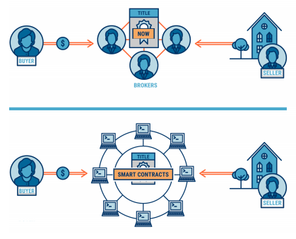
Current vs Proposed Commerce Model
(Top) Current distributed network of supply chain.
(Bottom) Proposed network using smart contracts which act as intelligent negotiator and auctioneer

Slide 5
Major Contributions
Double Auction Mechanism: For optimization of maximum profit for consumers and suppliers, an iterative auction mechanism is proposed. Smart Contract acts as an auctioneer to maximize overall profit while protecting privacy of users. In here, smart contract is a trusted third entity that executes the code and is visible to all the nodes in the blockchain network.
2) Credibility Scoring: Each user is accessed based on credibility score, trust and reputation. The proposed model provisions smart contract to eliminate the malicious or suspicious nodes using byzantine fault tolerant consensus mechanism.
3) Eliminating Middleman in Supply Chain: We propose a fully decentralised mechanism for providing services or trading between consumers and suppliers. This eliminates the privacy and security issues and cuts down the broker fees.

Slide 6
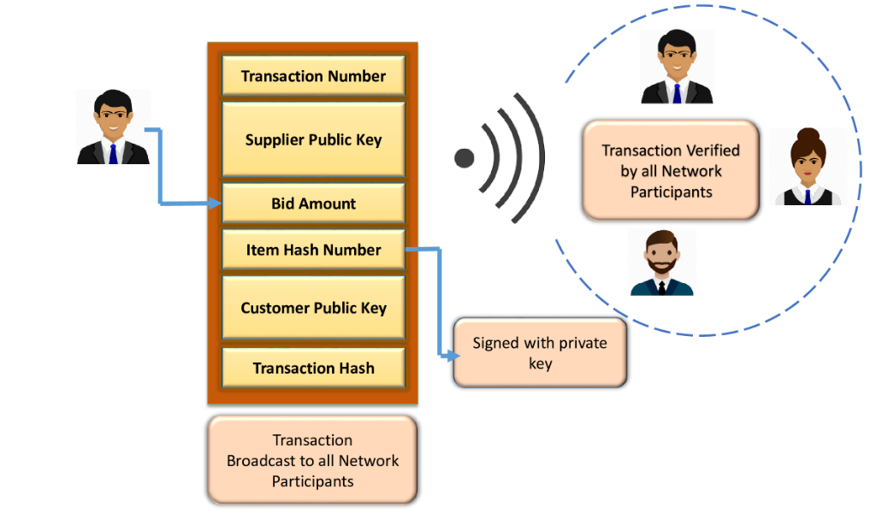
Block Header

Slide 7
Introducing Smart Contract
A smart contract is a computer protocol intended to digitally facilitate, verify, or enforce the negotiation or performance of a contract. Smart contracts allow the performance of credible transactions without third parties. These transactions are trackable and irreversible.
We introduce a smart contract which acts mediator between the consumer and supplier. The smart contract acts as an auctioneer, where the customers try to bid the least price to get the stakes. On the other hand sellers want to maximise the profit.
Notes:
- Calls generated on minutely basis
lambda= [4 27 35 40 45 47 50 35 20 10 3];
Hour_intervals= [0 2 4 6 8 10 12 14 16 18 20 22 24];
Normalised on hourly basis to plot the diagram
Max number of users =

Slide 8


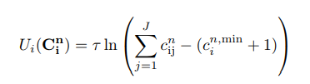

Problem Formulation
Total Demand of Consumer
Total Supply by the supplier
Trade Satisfaction
Here, τ is considered as a constant > 0 and
is the minimum requirement of the consumer.

Slide 9


Problem Formulation
The bid price vector for i^{th} consumer
bid price vector for j^{th} supplier
The auctioneer solves the following optimal allocation problem
Solved by smart contract using iterative double auction mechanism

Slide 10
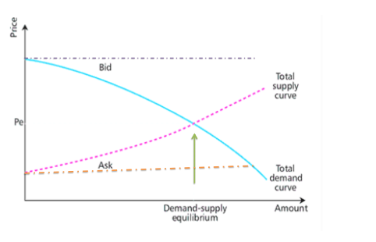
Demand-Supply Equilibrium
Above figure depicts how bidding price change for customer and supplier. Price refers to selling cost (Ask) of supplier. While amount refers to bidding cost (Bid) of customer. The double auction mechanism tries to optimise the maximum profit of both by reaching at demand-supply equilibrium.

Slide 11
Conclusions
In this work we:
Developed a model for applying blockchain in commerce for improved transparency, security and scalability.
Proposed a framework for use of flexible smart contracts to provide peer to peer auctioning without need of trusted party.
Introduced a mathematical parameter named credibility score which helps the nodes trust each other.

Slide 12
References
[1] C. Esposito, A. De Santis, G. Tortora, H. Chang, and K.- K. R. Choo, “Blockchain: A panacea for healthcare cloudbased data security and privacy?” IEEE Cloud Computing, vol. 5, no. 1, pp. 31–37, 2018.
[2] Hassija, V., Bansal, G., Chamola, V., Saxena, V. and Sikdar, B., 2019, May. Blockcom: A blockchain based commerce model for smart communities using auction mechanism. In 2019 IEEE International Conference on Communications Workshops (ICC Workshops) (pp. 1-6). IEEE.
[3] Bansal, G., V. Hassija, V. Chamola, N. Kumar, and M. Guizani. "Smart Stock Exchange Market: A Secure Predictive Decentralised Model." Proceedings of the 2019 IEEE Globecom, Big Island, HI, USA (2019): 9-13.
[4] Z. Li, J. Kang, R. Yu, D. Ye, Q. Deng, and Y. Zhang, “Consortium blockchain for secure energy trading in industrial internet of things,” IEEE transactions on industrial informatics, vol. 14, no. 8, pp. 3690–3700, 2018.
[5] Bansal, Gaurang, Amit Dua, Gagangeet Singh Aujla, Maninderpal Singh, and Neeraj Kumar. "SmartChain: a smart and scalable blockchain consortium for smart grid systems." In 2019 IEEE International Conference on Communications Workshops (ICC Workshops), pp. 1-6. IEEE, 2019.

